Slide 1
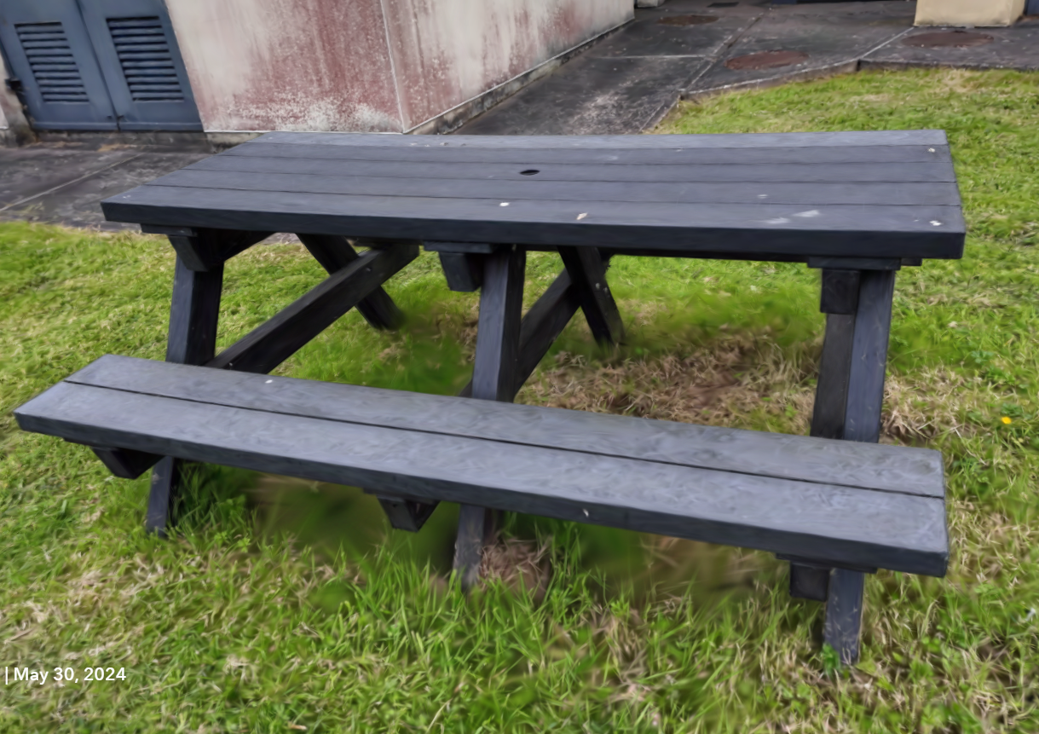
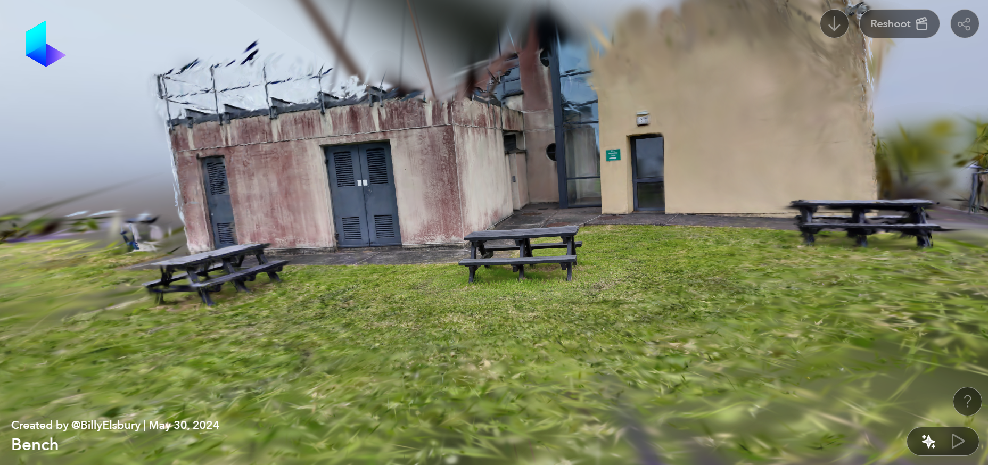
Capturing, Editing and Merging Gaussian Splats to Create Novel 3D Environments

Slide 2
Objectives and Research Area
Objectives:
To create, edit, and merge Gaussian Splats to develop novel and visually interesting 3D environments for game development and beyond.
Compare Gaussian Splatting with other emerging methods, such as Neural Radiance Fields (NeRF) and traditional photogrammetry.
Examine the limitations of Gaussian Splats in 3D environments.
Explore available tools for editing, enhancing, and extending the use of Gaussian Splats.
Research Area: Computer Graphics, Photogrammetry, 3D Rendering, and Game Development, with a specific focus on the editing, merging, and rendering of point cloud data using game engines.
Research Question: How can Gaussian Splats be edited and merged to create novel and visually impressive 3D environments for use in game development and beyond?

